Slide 1

Noida Institute of Engineering and Technology, Greater Noida
Theory of Computation
BCSE0404X
Regular Expression and Tokenization
Vivek Kumar Sharma
Assistant Professor
Computer Science and Engineering
B. Tech
(Computer Science & Engineering)
4th Semester

Slide 2
Faculty Introduction
Vivek Kumar Sharma is an Assistant Professor at Computer Science and Engineering Department, Noida Institute of Engineering and Technology, Gr Noida. He has done M. Tech. in 2013 and B.Tech in 2010. He is currently pursuing Ph.D. in Image Security.

Slide 3
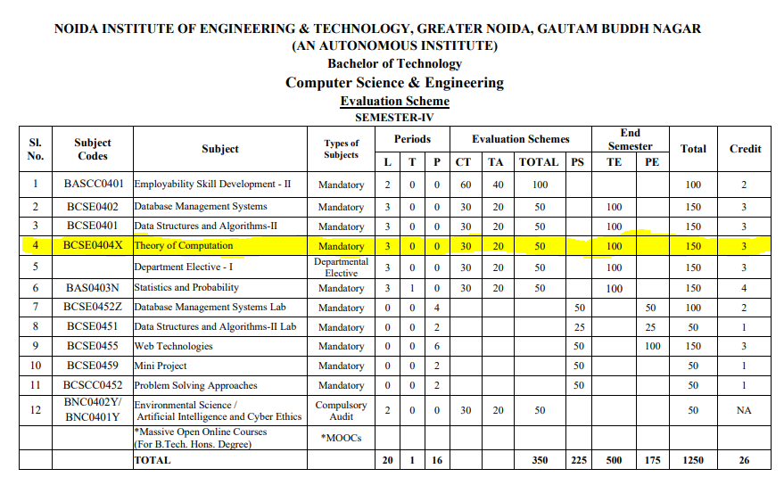
Evaluation Scheme

Slide 4

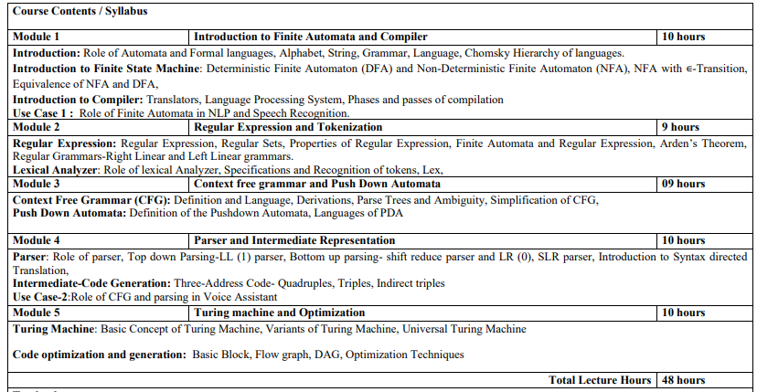
Syllabus

Slide 5
Branch wise Applications
Computer Science
Automaton is nothing but a machine which accepts the strings of a language L over an input alphabet Σ. There are four different types of Automata that are mostly used in various areas
Lexical analysis and regular expression matching in compilers and search engines.
Syntax parsing in programming language compilers and NLP.
Finite State Machines in hardware design, network protocols, and robotics.
Speech recognition using Hidden Markov Models (HMMs).
Text processing in editors and search tools.
Bioinformatics and genetic sequence analysis.

Slide 6
Course Objectives
The course objective of this course:
The primary objective of this course is to provide a foundational understanding of Automata Theory and its role in the language processing systems, also explores their application in fields like Natural Language Processing (NLP), speech recognition

Slide 7
Course Outcomes
CO | At the end of course , the student will be able to | Bloom’s (KL)
CO1 | Identify the fundamental concepts of automata theory, formal languages and compiler components | K₂
CO2 | Understand the role of finite automata, regular expressions, and grammar rules in language processing. | K₂
CO3 | Demonstrate context-free grammars, pushdown automata, and syntax-directed translation to construct intermediate code for language processors | K₃
CO4 | Analyze various parsing strategies, code translation methods, and intermediate representations in compiler phases. | K₄
CO5 | Analyze the functioning of Turing machine models and optimization techniques in code generation for performance improvement | K₄

Slide 8
Program Outcomes (POs)
Engineering Graduates will be able to:
1. Engineering knowledge: Apply the knowledge of mathematics, science, engineering fundamentals, and an engineering specialization to the solution of complex engineering problems.
2. Problem analysis: Identify, formulate, review research literature, and analyze complex engineering problems reaching substantiated conclusions using first principles of mathematics, natural sciences, and engineering sciences.
3. Design/development of solutions: Design solutions for complex engineering problems and design system components or processes that meet the specified needs with appropriate consideration for the public health and safety, and the cultural, societal, and environmental considerations.
4. Conduct investigations of complex problems: Use research-based knowledge and research methods including design of experiments, analysis and interpretation of data, and synthesis of the information to provide valid conclusions.

Slide 9

Program Outcomes (POs)
Contd..
5. Modern tool usage: Create, select, and apply appropriate techniques, resources, and modern engineering and IT tools including prediction and modeling to complex engineering activities with an understanding of the limitations.
6. The engineer and society: Apply reasoning informed by the contextual knowledge to assess societal, health, safety, legal and cultural issues and the consequent responsibilities relevant to the professional engineering practice.
7. Environment and sustainability: Understand the impact of the professional engineering solutions in societal and environmental contexts, and demonstrate the knowledge of, and need for sustainable development.
8. Ethics: Apply ethical principles and commit to professional ethics and responsibilities and norms of the engineering practice.

Slide 10
Program Outcomes (POs)
Contd..
9. Individual and team work: Function effectively as an individual, and as a member or leader in diverse teams, and in multidisciplinary settings.
10. Communication: Communicate effectively on complex engineering activities with the engineering community and with society at large, such as, being able to comprehend and write effective reports and design documentation, make effective presentations, and give and receive clear instructions.
11. Project management and finance: Demonstrate knowledge and understanding of the engineering and management principles and apply these to one’s own work, as a member and leader in a team, to manage projects and in multidisciplinary environments.
12. Life-long learning: Recognize the need for, and have the preparation and ability to engage in independent and life-long learning in the broadest context of technological change.

Slide 11
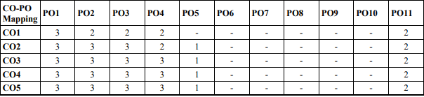
CO-PO correlation matrix

Slide 12
Program Specific Outcomes
On successful completion of graduation degree the Computer Science &
Engineering graduates will be able to:
PSO1: | identify, analyze real world problems and design their ethical solutions using artificial intelligence, robotics, virtual/augmented reality, data analytics, block chain technology, and cloud computing.
PSO2: | Design and develop the hardware sensor devices and related interfacing software systems for solving complex engineering problems.
PSO3: | understand inter-disciplinary computing techniques and to apply them in the design of advanced computing.
PSO4: | Conduct investigation of complex problem with the help of technical, managerial, leadership qualities, and modern engineering tools provided by industry sponsored laboratories.

Slide 13
CO-PSO correlation matrix
CO | PSO
 | PSO1 | PSO2 | PSO3 | PSO4
CO1 | 3 | 2 | 3 | 2
CO2 | 3 | 2 | 3 | 2
CO3 | 3 | 2 | 3 | 2
CO4 | 3 | 2 | 3 | 2
CO5 | 3 | 2 | 3 | 2
Average | 3 | 2 | 3 | 2

Slide 14

Program Educational Objectives
PEO’S of the B. Tech. in Computer Science and Engineering are:
The graduates will be able:
PEO 1: To have an excellent scientific and engineering breadth so as to comprehend, analyze, design and provide sustainable solutions for real-life problems using state-of-the-art technologies.
PEO 2: To have a successful career in industries, to pursue higher studies or to support entrepreneurial endeavors and to face global challenges.
PEO 3: To have an effective communication skill, professional attitude, ethical values and a desire to learn specific knowledge in emerging trends, technologies for research, innovation and product development and contribution to society.
PEO 4: To have life-long learning for up-skilling and re-skilling for a successful professional career as an engineer, scientist, entrepreneur, or bureaucrat for the betterment of the society.
.

Slide 15
CO-PEO correlation matrix
CO | PEO
 | PEO1 | PEO2 | PEO3 | PEO4
CO1 | 2 | 2 | 1 | 2
CO2 | 2 | 2 | 1 | 1
CO3 | 2 | 2 | 2 | 2
CO4 | 2 | 2 | 1 | 1
CO5 | 2 | 2 | 1 | 2
Average | 2 | 2 | 1.2 | 2

Slide 16
Result Analysis
Subject Result:
Section A: 95.65%
Section B: 97.14%
Section C: 84.51%
Section D: 94.29%

Slide 17
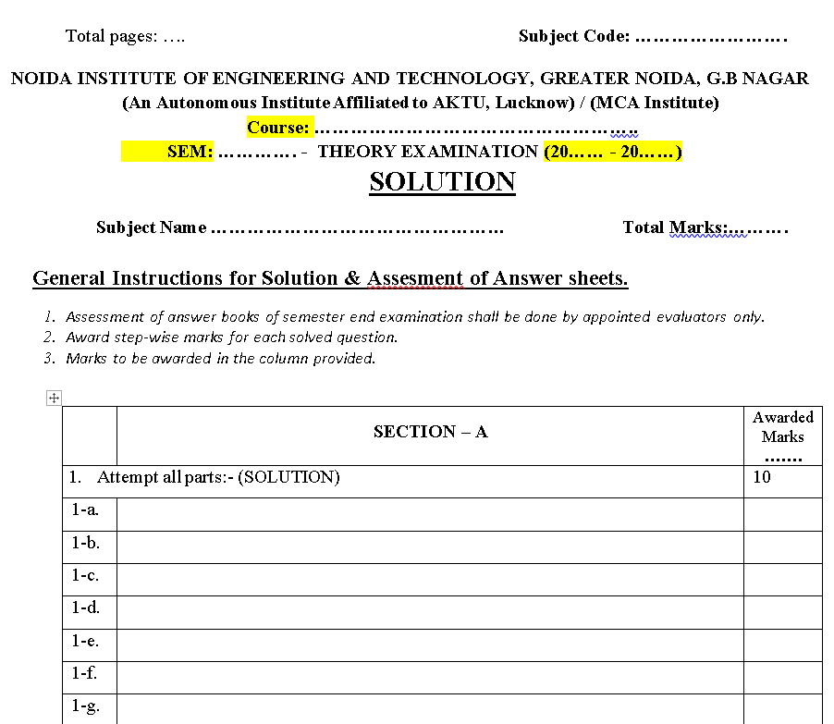
End Semester Question Paper Template

Slide 18

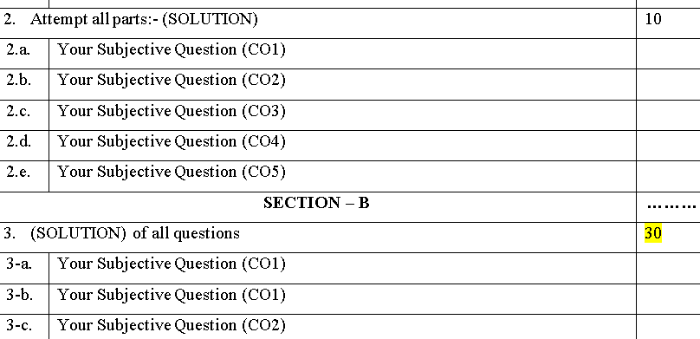
End Semester Question Paper Template

Slide 19
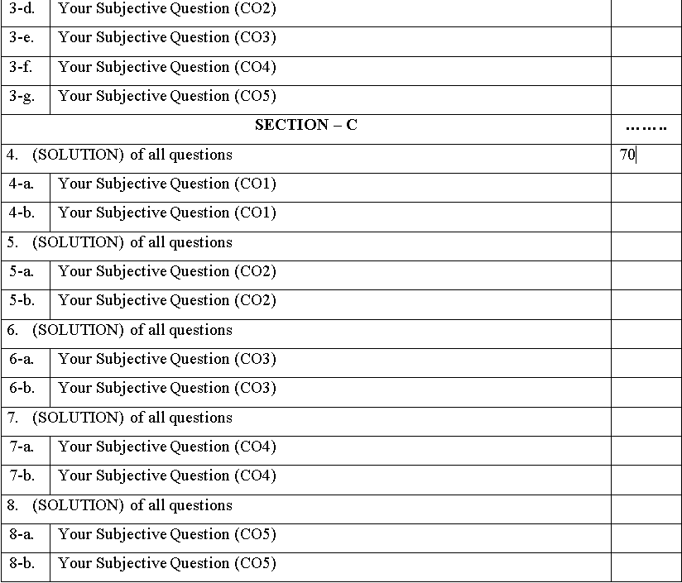
End Semester Question Paper Template

Slide 20
Prerequisite for the Course
Basics operations of mathematics.
Discrete mathematics.
Predicate logic.

Slide 21
Recap
Finite automata is an abstract computing device. It is a mathematical model of a system with discrete inputs, outputs, states and a set of transitions from state to state that occurs on input symbols from the alphabet Σ.

Slide 22
Brief subject introduction with Video Lecture
(73) TAFL1:Theory of Automata and Formal Language| Course Overview of automata, TOC Lectures in Hindi - YouTube
(73) TAFL2:Theory of Automata and Formal Language| Theory of Computation Tutorial Syllabus - YouTube

Slide 23
Unit Contents
Topics | Duration (in Hours)
Introduction | 3
Introduction to Finite State Machine | 4
Introduction to Compiler | 3
Topics | Duration (in Hours)
Assignment, Tutorials and Quiz | 1

Slide 24
Regular Expression(RE)
We have already discussed that languages accepted by Finite Automata are called Regular Language.
Regular expressions are an algebraic way to describe languages.
They describe exactly the regular languages.
If E is a regular expression, then L(E) is the language it defines.
We’ll describe RE’s and their languages recursively.
An expression that express the regular language is called the regular Expression
Any set that represents the value of the Regular Expression is called a Regular Set
RE is written for the Regular Language using +, . , * is known as Regular Expression.
Examples
(a+b)
(0+10*)
(a+Ɛ)b*a
(ab+ba)*

Slide 25
Regular Expression(RE)
Formally a regular expression is defined recursively as
Any terminal symbol (i.e. an element of ∑:), Ɛ and φ are regular expressions. When we view a in ∑ as a regular expression, we denote it by a.
The union of two regular expressions R1 and R2 written as R1+ R2, is also a regular expression.
The concatenation of two regular expressions R1 and R2, written as R1 . R2, is also a regular expression.
The iteration (or closure) of a regular expression R written as R*, is also a regular expression.
If R is a regular expression, then (R) is also a regular expression.
The regular expressions over ∑ are precisely those obtained recursively by the application of the rules 1-5 once or several times.

Slide 26
Regular Expression(RE)
Basis 1: If a is any symbol, then a is a RE, and L(a) = {a}.
Note: {a} is the language containing one string, and that string is of length 1.
Basis 2: ε is a RE, and L(ε) = {ε}.
Basis 3: ∅ is a RE, and L(∅) = ∅.
Induction 1: If E₁ and E₂ are regular expressions, then E₁+E₂ is a regular expression, and L(E₁+E₂) = L(E₁)∪L(E₂).
Induction 2: If E₁ and E₂ are regular expressions, then E₁E₂ is a regular expression, and L(E₁E₂) = L(E₁)L(E₂).
Concatenation : the set of strings wx such that w
is in L(E₁) and x is in L(E₂).

Slide 27
Regular Expression(RE)
Induction 3: If E is a RE, then E* is a RE, and L(E*) = (L(E))*.
Closure, or “Kleene closure” = set of strings w₁w₂…w_{n}, for some n > 0, where each w_{i} is in L(E).
Note: when n=0, the string is ε.

Slide 28
DFA, NFA, Ɛ-NFA and Regular Expression(RE)
RE
Ɛ-NFA
DFA
NFA

Slide 29
DFA, Regular Sets, Regular Expressions
Finite Automata | Regular Set | Regular Expression
 | {Ɛ} | RE = Ɛ
 | {φ} | RE = φ
 | {a} | RE = a
 | {a, b} | RE = a+b
q0
q0
a
q1
q0
a
q1
a
q0
b
q1

Slide 30
DFA, Regular Sets, Regular Expressions
Finite Automata | Regular Set | Regular Expression
 | {ab} | RE = a.b
 | {Ɛ,a,aa,aaa,……} | RE = a*
 | {a,aa,aaa,…….} | RE = a.a* = a⁺
 | {Ɛ, ab,abab,…….} | RE = (ab)*
q1
q2
q0
a
b
q0
a
a
q0
a
q1
a
q0
q1
b

Slide 31
Regular Expressions, Regular Sets
Regular Expressions | Regular Set
(0 + 10*) | L = { 0, 1, 10, 100, 1000, 10000, … }
(0*10*) | L = {1, 01, 10, 010, 0010, …}
(0 + ε)(1 + ε) | L = {Ɛ, 0, 1, 01}
(a+b)* | L = {Ɛ, a, b, aa , ab , bb , ba, aaa…….}
(a+b)*abb | L = {abb, aabb, babb, aaabb, ababb, …………..} ending with abb
(11)* | L= {Ɛ, 11, 1111, 111111, ……….}
(aa)*(bb)*b | Set of strings consisting of even number of a’s followed by odd number of b’s , so L = {b, aab, aabbb, aabbbbb, aaaab, aaaabbb, …………..}
(aa + ab + ba + bb)* | String of a’s and b’s of even length can be obtained by concatenating any combination of the strings aa, ab, ba and bb including null, so L = {Ɛ, aa, ab, ba, bb, aaab, aaba, …………..}

Slide 32
Examples of Regular Expression
Q1: Write the regular expression for the language accepting all combinations of a's, over the set ∑ = {a}
Solution:
All combinations of a's means a may be zero, single, double and so on. If a is appearing zero times, that means a null string. That is we expect the set of {ε, a, aa, aaa, ....}. So we give a regular expression for this as:
R = a*
That is Kleen closure of a.

Slide 33
Examples of Regular Expression
Q2: Write the regular expression for the language accepting all combinations of a's except the null string, over the set ∑ = {a}
Solution:
The regular expression has to be built for the language
L = {a, aa, aaa, ....}
This set indicates that there is no null string. So we can denote regular expression as: R = a⁺
Q3:Write the regular expression for the language accepting all the string containing any number of a's and b's.
Solution:
The regular expression will be:
r.e. = (a + b)*
This will give the set as L = {ε, a, aa, b, bb, ab, ba, aba, bab, .....}, any combination of a and b.
The (a + b)* shows any combination with a and b even a null string.

Slide 34
Examples of Regular Expression
Q4: Write the regular expression for the language accepting all the string which are starting with 1 and ending with 0, over ∑ = {0, 1}.
Solution:
In a regular expression, the first symbol should be 1, and the last symbol should be 0. The r.e. is as follows:
R = 1 (0+1)* 0
Q5: Write the regular expression for the language starting and ending with a and having any combination of b's in between.
Solution:
The regular expression will be:
R = a b* a

Slide 35
Examples of Regular Expression
Q6:
Write the regular expression for the language starting with ‘a’ but not having consecutive b's.
Solution: The regular expression has to be built for the language:
L = {a, aba, aab, aba, aaa, abab, .....}
The regular expression for the above language is:
R = {a + ab}*
Q7:
Write the regular expression for the language accepting all the string in which any number of a's is followed by any number of b's is followed by any number of c's.
Solution: As we know, any number of a's means a* any number of b's means b*, any number of c's means c*. Since as given in problem statement, b's appear after a's and c's appear after b's. So the regular expression could be:
R = a* b* c*

Slide 36
Examples of Regular Expression
Q8:Write the regular expression for the language over ∑ = {0} having even length of the string.
Solution:
The regular expression has to be built for the language:
L = {ε, 00, 0000, 000000, ......}
The regular expression for the above language is:
R = (00)*
Q9:
Write the regular expression for the language having a string which should have atleast one 0 and alteast one 1.
Solution:
The regular expression will be:
R = [(0 + 1)* 0 (0 + 1)* 1 (0 + 1)*] + [(0 + 1)* 1 (0 + 1)* 0 (0 + 1)*]

Slide 37
Examples of Regular Expression
Q10: Describe the language denoted by following regular expression
r.e. = (b* (aaa)* b*)*
Solution:
The language can be predicted from the regular expression by finding the meaning of it. We will first split the regular expression as:
r.e. = (any combination of b's) (aaa)* (any combination of b's)
L = {The language consists of the string in which a's appear triples, there is no restriction on the number of b's}
Q11:
Write the regular expression for the language L over ∑ = {0, 1} such that all the string do not contain the substring 01.
Solution:
The Language is as follows:
L = {ε, 0, 1, 00, 11, 10, 100, .....}
The regular expression for the above language is as follows:
R = (1* 0*)

Slide 38
Examples of Regular Expression
Q12:
Write the regular expression for the language containing the string over {0, 1} in which there are at least two occurrences of 1's between any two occurrences of 1's between any two occurrences of 0's.
Solution: At least two 1's between two occurrences of 0's can be denoted by (0111*0)*.
Similarly, if there is no occurrence of 0's, then any number of 1's are also allowed. Hence the r.e. for required language is:
R = (1 + (0111*0))*
Q13:
Write the regular expression for the language containing the string in which every 0 is immediately followed by 11.
Solution:
The regular expectation will be:
R = (011 + 1)*

Slide 39
Converting a RE to an ε-NFA
Proof is an induction on the number of operators (+, concatenation, *) in the RE.
We always construct an automaton of a special form (next slide).
39

Slide 40
Form of ε-NFA’s Constructed
No arcs from outside,
no arcs leaving
Start state:
Only state
with external
predecessors
“Final” state:
Only state
with external
successors
40

Slide 41
RE to ε-NFA: Basis
Symbol a:
ε:
∅:
a
ε
41

Slide 42
RE to ε-NFA: Induction 1 – Union
For E₁
ε
ε
For E₂
ε
ε
For E₁ ∪ E₂

Slide 43
RE to ε-NFA: Induction 2 – Concatenation
For E₁
For E₂
ε
For E₁E₂

Slide 44
RE to ε-NFA: Induction 3 – Closure
ε
For E
ε
ε
ε
For E*

Slide 45

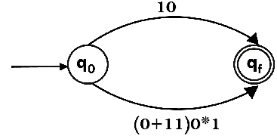
Example of RE to NFA
Design a FA from given regular expression 10 + (0 + 11)0* 1.
Solution: First we will construct the transition diagram for a given regular expression.
Step 1:
Step 2:

Slide 46
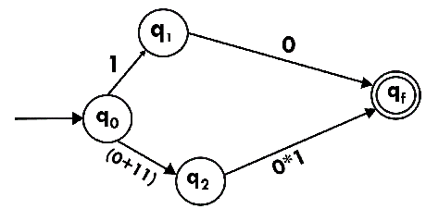
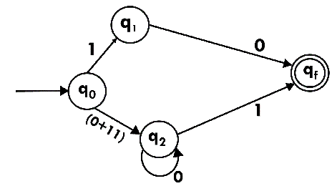
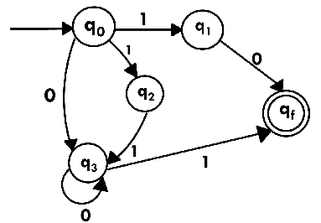
Example of RE to NFA
Step 3:
Step 4:
Step 5:
46

Slide 47

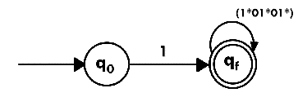
Example of RE to NFA
Design a NFA from given regular expression 1 (1* 01* 01*)*.
Solution: The NFA for the given regular expression is as follows:
Step 1:
Step 2:

Slide 48
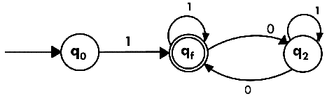

Example of RE to NFA
Step 3:
Construct the FA for regular expression 0*1 + 10.
Solution:
We will first construct FA for R = 0*1 + 10 as follows:
Step 1:

Slide 49
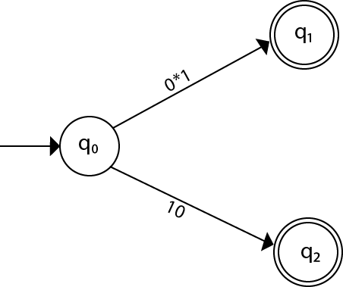
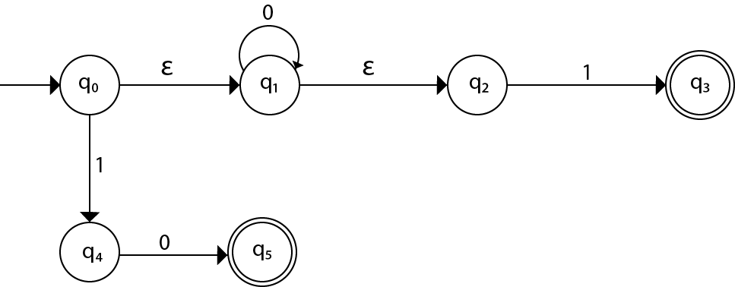
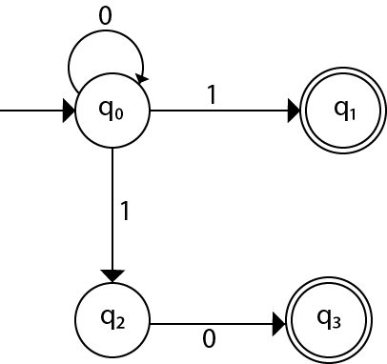
Example of RE to NFA
Step 2:
Step 3:
Step 4:
49

Slide 50
Construct an NFA for a*b*c*.
Regular Expression to NFA
a
b
c
q0
q1
q2
Ɛ
Ɛ

Slide 51
Construct an NFA for a(a+b)*b.
Regular Expression to NFA
Ɛ-NFA
a,b
q0
a
q1
Ɛ
q2
Ɛ
q3
b
q4
NFA
a,b
q0
a
q2
b
q4

Slide 52
Arden’s Theorem
Let P and Q be two regular expressions. If P does not contain Ɛ, then
R = Q + RP has a unique solution that is
R = QP*
R = Q+RP
= Q + (Q + RP)P
= Q + QP + RP²
= Q + QP + (Q + RP)PP
= Q + QP + QP² + RP³
=…
=…
= Q + QP + QP² +_ _ _ _ + QP^{n} + RP^{n+1}
= Q + QP + QP² +_ _ _ _ + QP^{n} + QP*P^{n+1}
=Q ( Ɛ+ P + P2 + _ _ _ _ + P^{n} + P*P^{n+1})
=QP*
Hence, R=QP* is a Unique Solution.
Proof
R=Q+RP
= Q+QP*P
= Q(Ɛ + P*P)
= QP*
So, R = QP* is a solution.

Slide 53

Example of Arden’s theorem
Q1: Construct the regular expression for the given DFA
Solution:
Let us write down the equations
q1 = q1 0 + ε
Since q1 is the start state, so ε will be added, and the input 0 is coming to q1 from q1 hence we write State = source state of input × input coming to it
Similarly,
q2 = q1 1 + q2 1
q3 = q2 0 + q3 (0+1)

Slide 54
Example of Arden’s theorem
Since the final states are q1 and q2, we are interested in solving q1 and q2 only. Let us see q1 first
q1 = q1 0 + ε
We can re-write it as
q1 = ε + q1 0
Which is similar to R = Q + RP, and gets reduced to R = OP*.
Assuming R = q1, Q = ε, P = 0
We get
q1 = ε.(0)* q1 = 0* (ε.R*= R*)
Substituting the value into q2, we will get
q2 = 0* 1 + q2 1 q2 = 0* 1 (1)* (R = Q + RP → Q P*)
The regular expression is given by
r = q1 + q2 = 0* + 0* 1.1* r = 0* + 0* 1⁺ (1.1* = 1⁺)

Slide 55
Example of Arden’s theorem
Q2:Find regular expression for the following DFA using Arden’s Theorem-
Solution-
Step-01:
Form a equation for each state-
q1 = ∈ ……(1)
q2 = q1.a ……(2)
q3 = q1.b + q2.a + q3.a …….(3)
Step-02:
Bring final state in the form R = Q + RP.
Using (1) in (2), we get-
q2 = ∈.a
q2 = a …….(4)

Slide 56
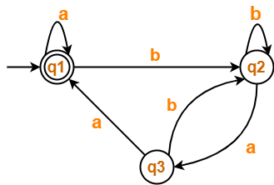
Example of Arden’s theorem
Using (1) and (4) in (3), we get-
q3 = q1.b + q2.a + q3.a
q3 = ∈.b + a.a + q3.a
q3 = (b + a.a) + q3.a …….(5)
Using Arden’s Theorem in (5), we get-
q3 = (b + a.a)a*
Thus, Regular Expression for the given DFA = (b + aa)a*
Q3: Find regular expression for the following DFA using Arden’s Theorem-

Slide 57
Example of Arden’s theorem
Step-01:
Form a equation for each state-
q1 = ∈ + q1.a + q3.a ……(1)
q2 = q1.b + q2.b + q3.b ……(2)
q3 = q2.a …….(3)
Step-02:
Bring final state in the form R = Q + RP.
Using (3) in (2), we get-
q2 = q1.b + q2.b + q2.a.b
q2 = q1.b + q2.(b + a.b) …….(4)
Using (3) in (2), we get-
q2 = q1.b + q2.b + q2.a.b
q2 = q1.b + q2.(b + a.b) …….(4)

Slide 58
Example of Arden’s theorem
Using (5) in (3), we get-
q3 = q1.b.(b + a.b)*.a …….(6)
Using (6) in (1), we get-
q1 = ∈ + q1.a + q1.b.(b + a.b)*.a.a
q1 = ∈ + q1.(a + b.(b + a.b)*.a.a) …….(7)
Using Arden’s Theorem in (7), we get-
q1 = ∈.(a + b.(b + a.b)*.a.a)*
q1 = (a + b.(b + a.b)*.a.a)*
Thus, Regular Expression for the given DFA = (a + b(b + ab)*aa)*

Slide 59
Algebraic method using Arden’s theorem
Arden’s theorem state that: “If P and Q are two regular expressions over “∑”, and if P does not contain “∈” , then the following equation in R given by R = Q + RP has a unique solution i.e., R = QP*.” That means, whenever we get any equation in the form of R = Q + RP, then we can directly replace it with R = QP*. So, here we will first prove that R = QP* is the solution of this equation and then prove that it is the unique solution of this equation. Let’s start by taking this equation as equation (i)
1. proof R = QP* is the solution of R = Q + RP
R = Q + RP ......(i) Now, replacing R by R = QP*, we get,
R = Q + QP*P Taking Q as common,
R = Q( ∈ + P*P) = QP*
(As we know that ∈ + R*R = R*). Hence proved. Thus, R = QP* is the solution of the equation R = Q + RP. Now, we have to prove that this is the only solution to this equation.

Slide 60
Algebraic method using Arden’s theorem
2. proof R = QP* is the unique solution of R = Q + RP
Let me take this equation again:
R = Q + RP Now, replace R by R = Q + RP,
R = Q + (Q + RP)P = Q + QP + RP²
Again, replace R by R = Q + RP
R = Q + QP + (Q + RP) P² = Q + QP + QP² + RP³ . . = Q + QP + QP² + .. + Q + RP^{(n+1)}
Now, replace R by R = QP*, we get,
R = Q + QP + QP² + .. + QP^{n}+ QP*P^{(n+1)}
Taking Q as common,
R = Q( ∈ + P + P² + .. + P^{n} + P*P^{(n+1)} = QP*
[As ∈ + P + P² + .. + P^{n} + P*P^{(n+1)} represent the closure of P] Hence proved. Thus, R = QP* is the unique solution of the equation R = Q + RP.

Slide 61
Identities of Regular Expression
I₁: R + ∅ = ∅ + R = R
I₂: R. ∅ = ∅
I₃: R.ε = ε.R = R
I₄: ε* = ε
I₅: R+R=R
I₆: R*R* = R*
I₇: RR* = R*R
I₈: (R*)* = R*
I₉: ε + RR* = ε + R*R = R*
I₁₀: (PQ)*P =P(QP)*
I₁₁: (P+Q)* = (P*Q*)* = (P*+Q*)*
I₁₂: PQ+PR = P(Q+R) and QP+RP = (Q+R)P

Slide 62
Examples of Regular Expression
L(01) = {01}.
L(01+0) = {01, 0}.
L(0(1+0)) = {01, 00}.
Note order of precedence of operators.
L(0*) = {ε, 0, 00, 000,… }.
L((0+10)*(ε+1)) = all strings of 0’s and 1’s without two consecutive 1’s.

Slide 63
Regular grammar
Type-3 grammar/Regular grammar:
Regular grammar generates regular language. They have a single non-terminal on the left-hand side and a right-hand side consisting of terminal’s or terminal’s followed by a non-terminal or vice versa.
The productions must be in the form:
A ⇢ wB
A ⇢ w
Where w ∈ T*
A ⇢ Bw where A, B ∈ Variable(V) and w ∈ T* i.e. string of terminals.
Types of regular grammar:
Left Linear grammar(LLG)
Right linear grammar(RLG)

Slide 64
Regular grammar
1. Left linear grammar(LLG): In LLG, the productions are in the form if all the productions are of the form
A ⇢ Bw
A ⇢ w where A,B ∈ V and w ∈ T*
2. Right linear grammar(RLG): In RLG, the productions are in the form if all the productions are of the form
A ⇢ wB
A ⇢ w where A,B ∈ V and w ∈ T*

Slide 65
DFA to Right Linear Regular Grammar
Given a DFA:
a
_{q0}
_{q1}
a
b
b
b
b
a
_{q2}
_{q3}
a

Slide 66
DFA to Right Linear Regular Grammar (Continued)
Step 1: Rename the states: for q0 which is start state make it as S. rest as a non terminals like A,B,C…
a
_{S}
_{A}
a
b
b
b
b
a
_{B}
_{C}
a

Slide 67
DFA to Right Linear Regular Grammar (Continued)
Step 2: Set of productions are given by:
S → aA|bB
A → aS|bC|b
B → bs|aC|a
C → aB|bA
a
_{S}
_{A}
a
b
b
b
b
a
_{B}
_{C}
a

Slide 68
Right Linear Grammar to DFA
Convert the given Right Linear Grammar to DFA :
S →bB
B →bC|b
B →aB
C →a
STEP 1: Adding transactions corresponding to every production ,we get:
a
_{S}
b
_{B}
b
_{C}
a
_{D}

Slide 69
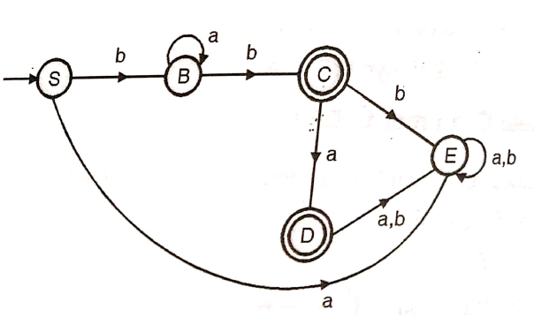
Right Linear Grammar to DFA (Continued)
STEP 2: Adding a state E to handle Φ transitions , final DFA will be:

Slide 70
DFA to Left Linear Grammar
Following steps are required to write a left linear grammar corresponding to a DFA.
Interchange starting state and the final state.
Reverse the direction of all the transactions.
Write the grammar from the transaction graph in left linear form.

Slide 71
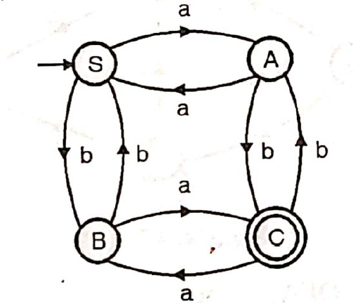
DFA to Left Linear Grammar
Following DFA is Given:

Slide 72
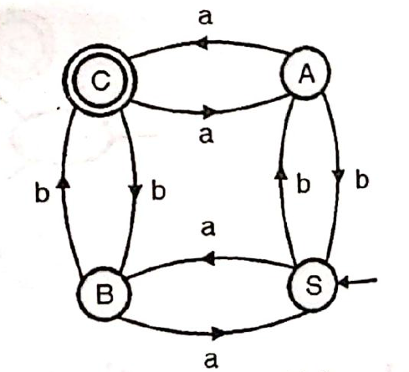
DFA to Left Linear Grammar(Continued)
Interchange the starting state and the final state and reverse the direction of transactions, we get the transaction graph as following:
Writing an equivalent left linear grammar, we get:
S →Ba|Ab, A →Sb|Ca|a
B →Sa|Cb|b, C →Bb|Aa

Slide 73
Left Linear Grammar to DFA
Every left linear grammar can be represented using an equivalent DFA. Following steps are required to draw a DFA for a given left linear grammar.
Draw a transaction graph from the given left linear grammar.
Reverse the direction of all the transactions.
Interchange starting state and the final state.
Carry out conversion from FA to DFA.

Slide 74
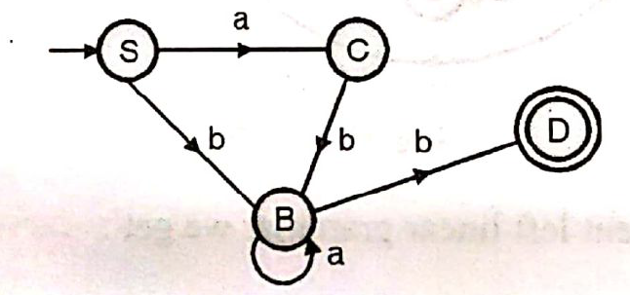
Left Linear Grammar to DFA (Example)
Following Linear grammar is given:
S →Ca|Bb
C →Bb
B →Ba|b
Step 1: Draw a transaction graph from the given left linear grammar:
D is an accepting state. It is added for the production B → b

Slide 75
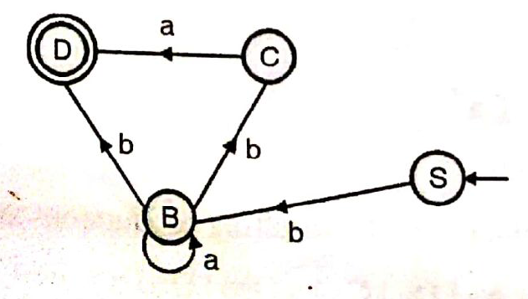
Left Linear Grammar to DFA (Example)
Step 2: Reverse the direction of transaction and interchange starting state and the final state.

Slide 76
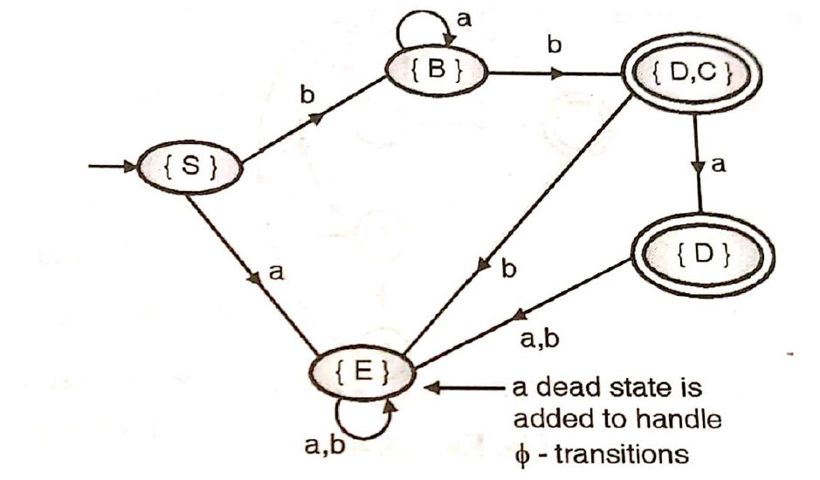
Left Linear Grammar to DFA (Example)
Conversion from FA to DFA:

Slide 77
Video Links
My Video Channel:
https://www.youtube.com/playlist?list=PLKhyqvN-JcP5AF4UzRz9wxFVBm63igm7y
NPTEL Video Links
https://youtu.be/vQeROGcwQs4
https://youtu.be/XxuH_K-wzpg
https://youtu.be/C7LqbEunJ1Y

Slide 78
Daily Quiz
1. If L1 and L2 are regular languages is/are also regular language(s).
L1 + L2
L1L2
L1’
All of above
2. Every regular expression can be expressed as CFG but every CFG cannot be expressed as a regular expression. this statement is :
True
False
depends on language
None of the option

Slide 79
Daily Quiz
3. The given NFA corresponds to which of the following Regular expressions?
(0+1) *(00+11) (0+1) ⁺
(0+1) *(00+11) *(0+1) *
(0+1) *(00+11) (0+1)
(0+1) (00+11) (0+1) *

Slide 80
Daily Quiz
4. Regular grammar is a) context free grammar b) non context free grammar c) English grammar d) none of the mentioned
5. Which of the following is true? a) Every subset of a regular set is regular b) Every finite subset of non-regular set is regular c) The union of two non regular set is not regular d) Infinite union of finite set is regular
6. Regular expressions are closed under a) Union b) Intersection c) Kleen star d) All of the mentioned

Slide 81
Weekly Assignment
1. Find a regular expression corresponding to each of the following subsets of {a. b}. [CO2]
The set of all strings containing exactly 2a’s.
The set of all strings containing at least 2a’s.
The set of all strings containing at most 2a's.
The set of a]] strings containing the substring aa.
2. Find the sets represented by the following regular expressions. [CO2]
(a + b)*(aa + bb + ab + ba)*
(aa)* + (aaa)*
(1 + 01 + 001)*(∊+ 0 + 00)
a + b(a + b)*

Slide 82
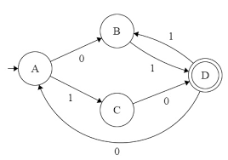
Weekly Assignment
Prove the identity: (a*ab + ba)*a* = (a + ab + ba)* [CO2]
Find the regular expression corresponding to the automaton given in Fig.

Slide 83
Weekly Assignment
5. State and prove Arden’s theorem. Give a regular expression for the Finite Automaton M=[{A ,B, C, D}, {a, b}, δ, A, {A}] where δ is given below: [CO2]
δ (A, a) = B δ (A, b) = C
δ (B, a) = D δ (B, b) = A
δ (C, a} = A δ (C, b) = D
δ (D, a) = D δ (D, b) = D

Slide 84
MCQ s
Let a Grammar G is defined by the production S→aS | bS , then language generated by Grammar is defined as
Φ
∊
{a,b}*
{a,b}+
Which of the following is true?
(01)*0 = 00(10)*
(0+1)*0(0+1)*1(0+1) = (0+1)*01(0+1)*
(0+1)*01(00+1)*+1*0* = (0+1)*
All of the mentioned

Slide 85
MCQ s
Which among the following looks similar to the given expression? ((0+1). (0+1))*
{xϵ {0,1} *|x is all binary number with even length}
{xϵ {0,1} |x is all binary number with even length}
{xϵ {0,1} *|x is all binary number with odd length}
{xϵ {0,1} |x is all binary number with odd length}
Which of the following represents a language which has no pair of consecutive 1’s if ∑= {0,1}?
(0+10)*(1+ε)
(0+10)*(1+ε)*
(0+101)*(0+ε)
(1+010)*(1+ε)

Slide 86
Topic Objective(CO1)
Introduce students to the concepts of scanner how a lexical analyzer work in compiler designing

Slide 87
Lexical Analyszer
Lexical Analyzer coverts Source Program into Stream of Tokens.
Also called Scanning Phase.
Lexical Analyzer’s main task is to read the input characters and produce output as sequence of tokens that the parser uses for syntax analysis.

Slide 88
Lexical Analysis(CO1)
Interface diagram of Lexical Analysis
token
Source
program
Lexical Analyzer
Syntax Analysis
To semantic
analysis
Get Next Token
Symbol
table

Slide 89
Functions of Lexical Analyzer(CO1)
Reads the input program character by character & produce a stream of token.
Removing white spaces / tabs.
Remove comments from source program.
Lexical Analyzer generates errors and gives the line number of the error.

Slide 90
Tokens
Tokens- Sequence of characters that have a collective meaning and treated as a single logical entity.
Tokens are symbolic names for the entities that make up the text of the program.
Typical Tokens are:
{ Keywords , Identifiers, Operators , Separators etc }
(for, if, while) (variable name, ( +, - , * , ++ ) ( , ; etc )
function name)
Ex: int a = 15 ;
(keyword) (identifier) (operator) (constant) (separator)

Slide 91
Tokens
Keyword: Word (for, if, else, …) which may have a particular predefined meaning to the compiler.
Identifier : Words that the programmer construct to attach a name .
Operator: Symbols used for arithmetic , character or logical operations such as +, - , = , !
Numeric Constant : Numbers such as 124, 12.35 , 0.09 E – 23 etc. These must be converted to a numeric format so that they can be used in arithmetic operations.
Character Constant : Single character or string of characters enclosed in quotes.
Special Characters : Character used as delimiters such as . , ( , ) ,{, } , ; . These are generally single character words.

Slide 92
Tokens
Note :
Comments : Not put out as tokens to next phase of compiler.
White Space : Space and tabs are generally ignored by the compiler and are not put out as tokens.
New lines: New line characters should also be ignored.

Slide 93
Tokens
Count the number of tokens.
int main ( )
{
/* find the Max of a and b */
int a = 20 , b = 30 ;
if ( a < b )
return ( b ) ;
else
return ( a ) ;
}

Slide 94
Tokens
Count the number of tokens.
1 2 3 4
int main ( )
5
{
/* find the Max of a and b */
6 7 8 9 10 11 12 13 14
int a = 20 , b = 30 ;
15 16 17 18 19 20
if ( a < b )
21 22 23 24 25
return ( b ) ;
26
else
27 28 29 30 31
return ( a ) ;
32
}

Slide 95
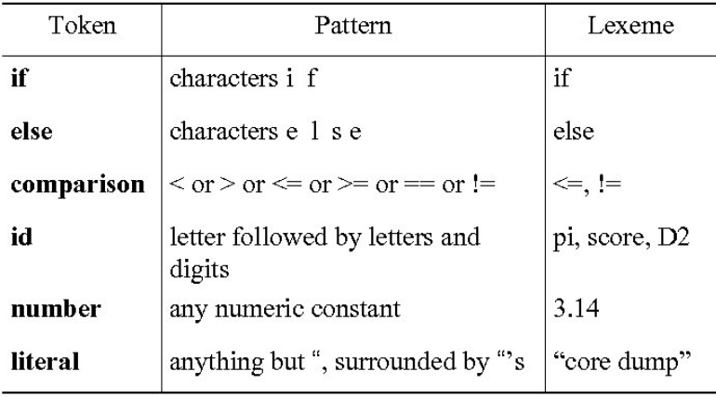
Example of Tokens, Patterns and Lexemes
Keyword
Keyword
Operator
Identifier
Constant
Constant

Slide 96
Lexeme & Pattern
Patterns- Rule that check Lexeme is valid token or not.
or
Pattern is a rule describing all those lexemes that can represent a particular token in a source language.
Lexeme- A sequence of characters in the source program that is matched by the pattern for a token.
or
A sequence of input characters that comprises a single token is called a lexeme.

Slide 97
Lex
Lex is a tool which generates Lexical Analyzer .
Lex written by Mike Lesk and Eric Schridt and described in 1975.

Slide 98
Block diagram of Lex
Lex Source Program
(File.l)
Lex Compiler
Lex.yy.c
(C program)
Lex.yy.c
C Compiler
a.Out
(Lexical Analyzer)
Input stream or HLL
a.out
stream of tokens

Slide 99
Lex
Source Code is in Lex language with file name .l extension.
It is given to Lex Compiler which is the Lex tool and produce lex.yy.c
C compiler runs this C Code ie lex.yy.c program and produce an output a.out .
a.out transforms an input stream into a sequence of tokens.

Slide 100
Structure of LEX
Lex Program is separated into 3 sections by %% delimeters.
{declaration} {{ declaration of variables including files / libraries}}
%%
{ Translation Rules} {{Contains rules in form of regular Expression}}
%%
{ Auxiliary functions}
Ex :
% { # include < stdio.h> declarartion
int c = 0 ;
%}
%%
pattern { action } {{Contains rules in form of regular Expression}}
%%
main ( )
{ }

Slide 101
Structure of LEX
Lex Program is separated into 3 sections by %% delimeters.
{declaration} {{ declaration of variables including files / libraries}}
%%
{ Translation Rules} {{Contains rules in form of regular Expression}}
%%
{ Auxiliary functions}
Ex :
% { # include < stdio.h> declarartion
int c = 0 ;
%}
%%
pattern { action } {{Contains rules in form of regular Expression}}
%%
main ( )
{ }

Slide 102
Rule and function used
Rule :
abc : match abc
[a – z] : match small a to z
[a – z ]* : match all string in small letters with null or more than 1 character.
[a – z ]+ : 1 or more character.
^a means a should come at start.
a$ means a at end
[0 – 9 ]+ 1 or more digit
Functions:
YY wrap( ) : called by lex tool when Input is exhausted. Return 1 if input is finished else 0
YY lex ( ) : reads the input stream and generate tokens according to the regular expression written in rules section.
YY text ( ) : pointer to the input string.

Slide 103
Thank You

